Slide 1
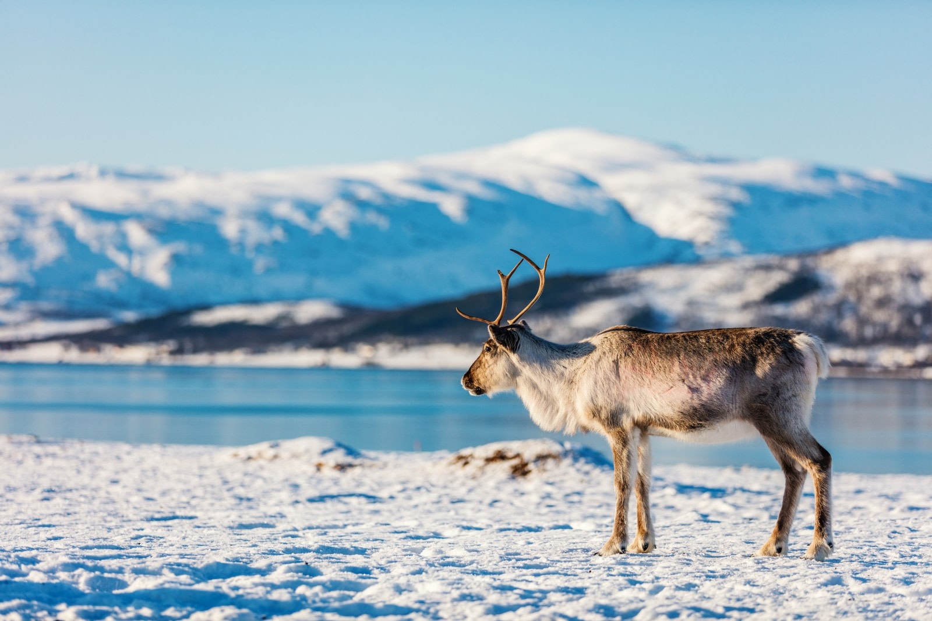

ENVIRONMENTAL IMPACT REVIEW BOARD
Inuvialuit Settlement Region Community Tour
February 2023
Notes:
Hello Everyone and thank you for joining us this afternoon.
We are the Environmental Impact Review Board (EIRB) and today we will be talking about what we do and how we do it.

Slide 2



Agenda
N E X T
The IFA, ISR & Co-Management Boards
The EIRB
The Review Guidelines
Notes:
Our agenda today will firstly revolve around the Inuvialuit Final Agreement, The Inuvialuit Settlement Region and the Co-Management Boards.
Then we will be talking about the Environmental Impact review board and how operate we through our Review Guidelines.

Slide 3
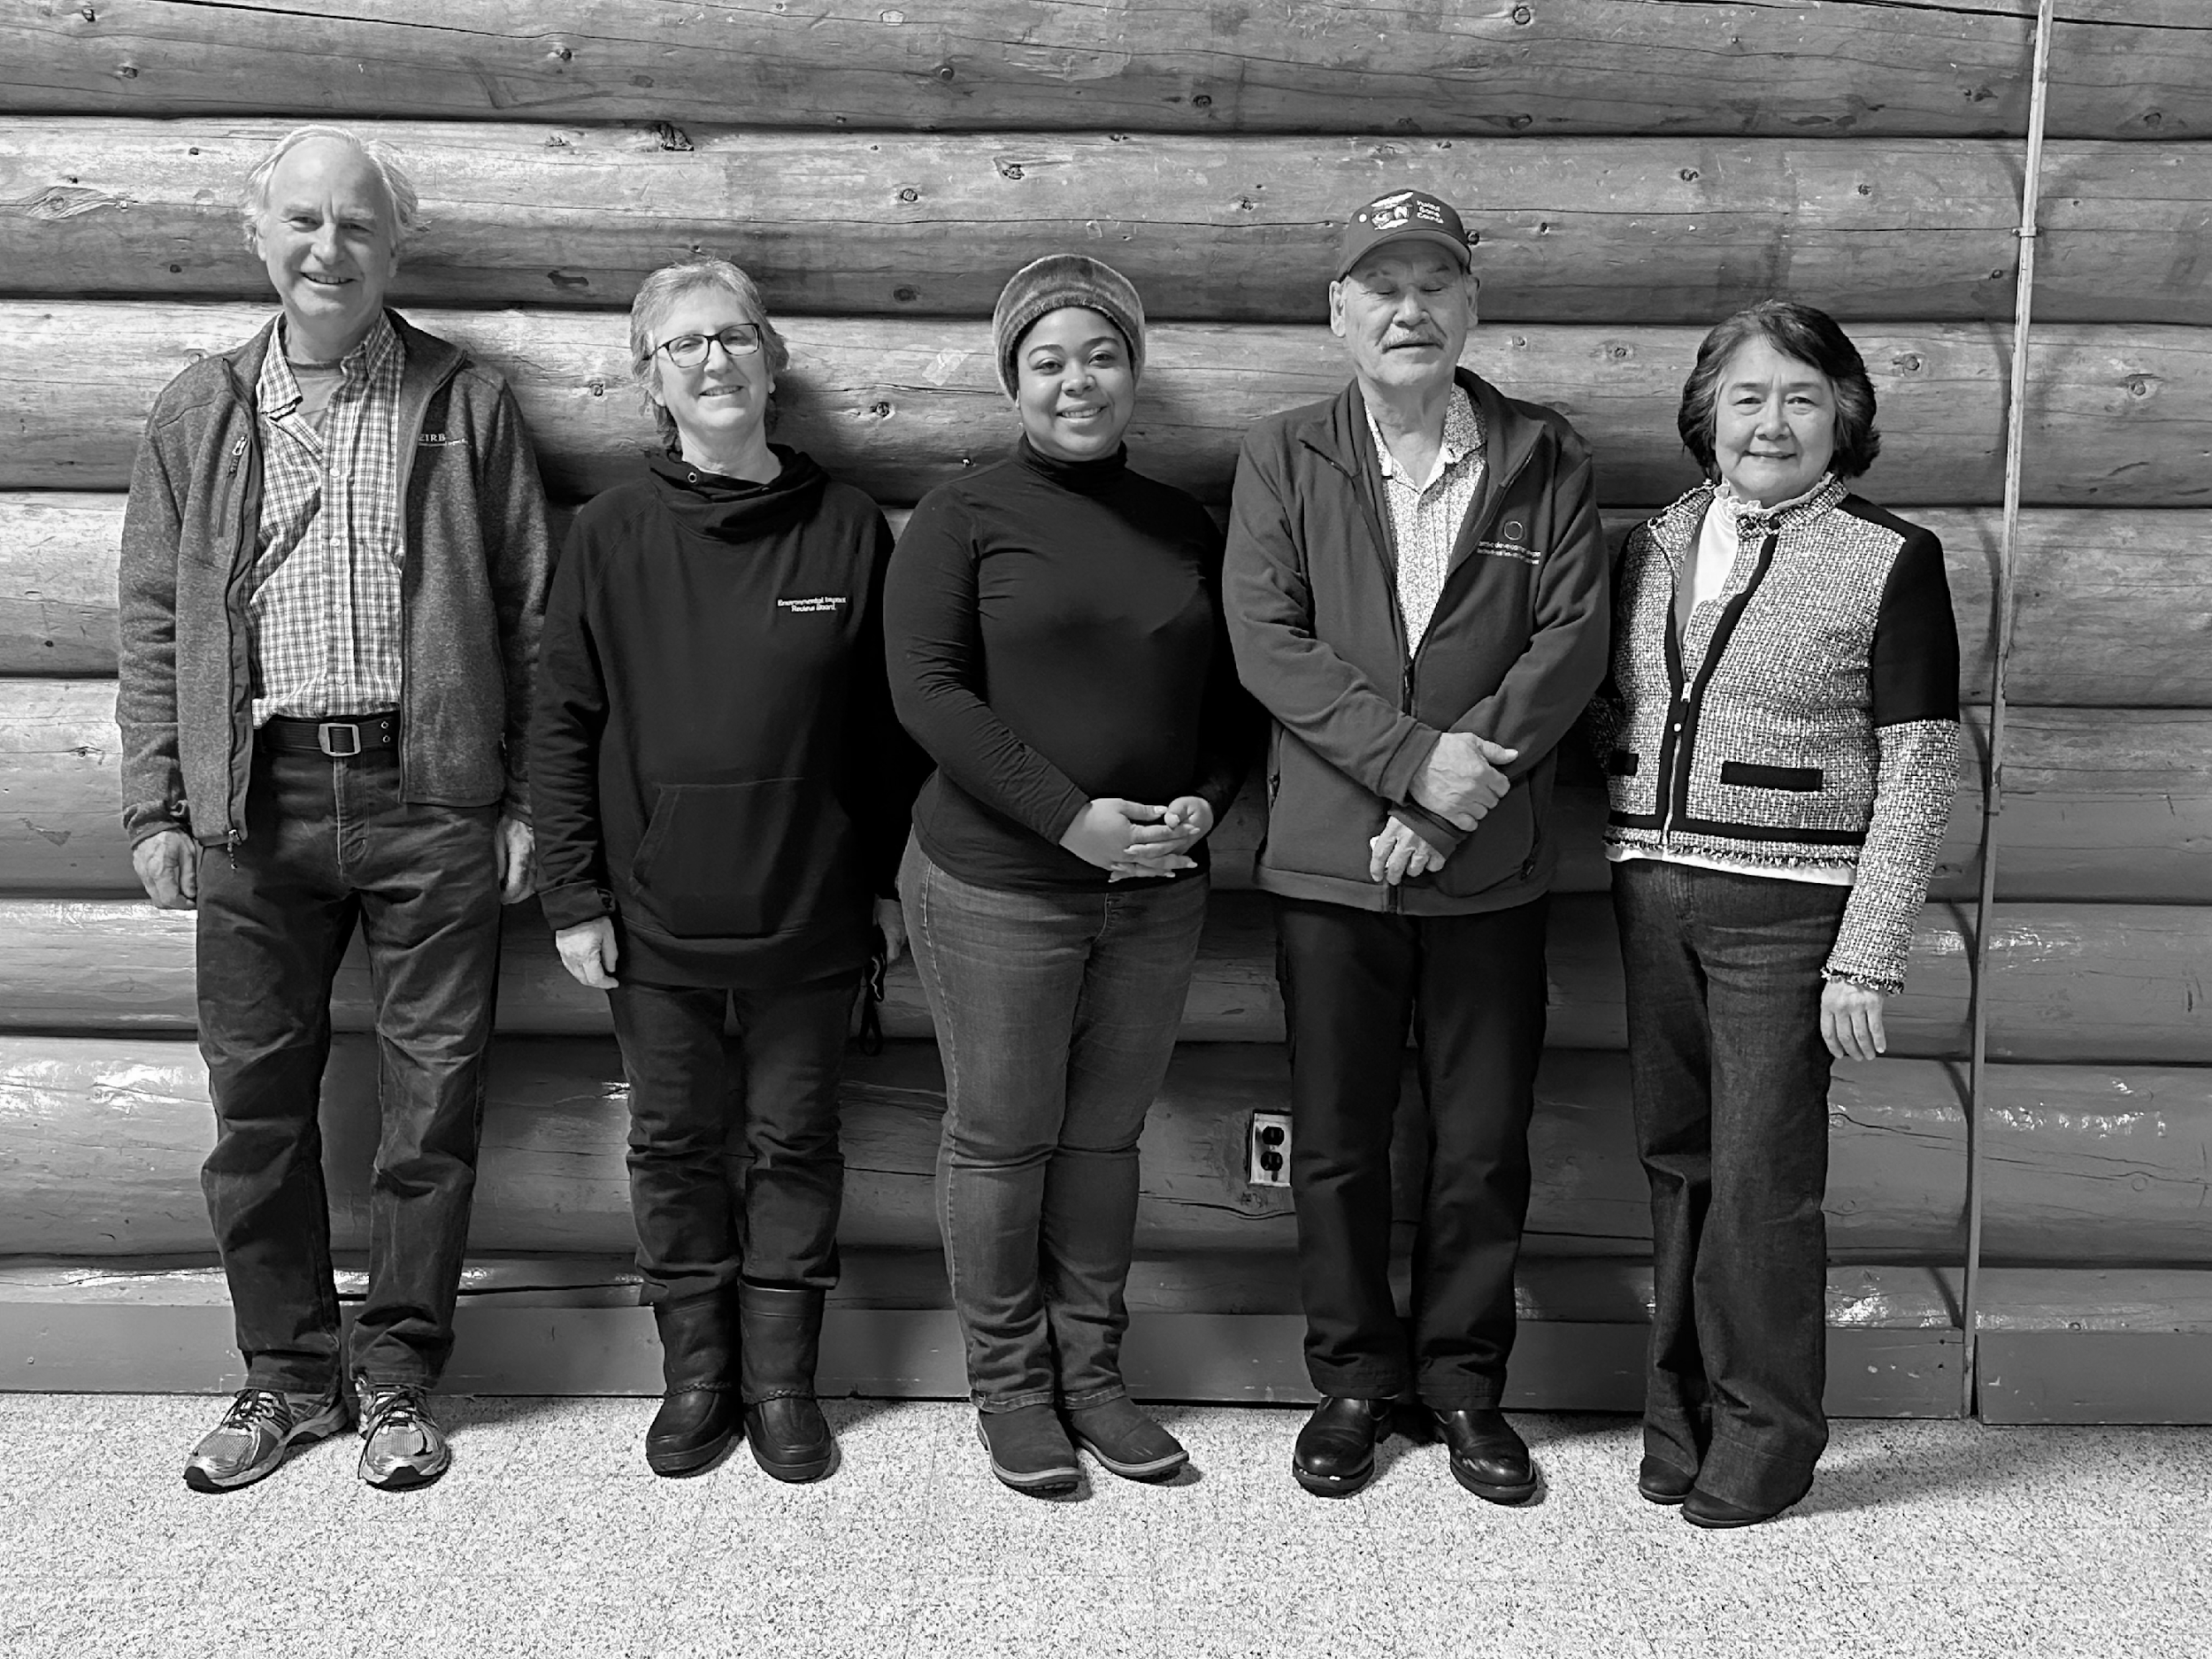
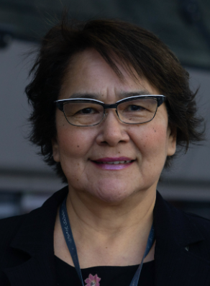
Catherine Cockney
Chair
Meet our Board Members
Appointed July 19, 2022, for a term of 3 years, ending August 20, 2025
EIRB Community Tour, 2023 - The EIRB
Notes:
But Before we get started, I would like to introduce our Board members.
Appointed on July 19, 2022 for a term of 3 years ending august 20th, 2025, our Chair, Catherine Cockney!

Slide 4
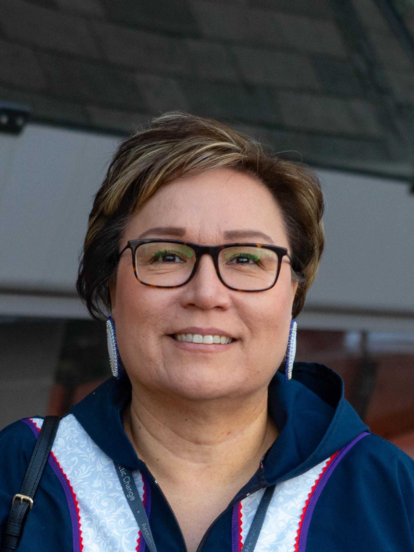

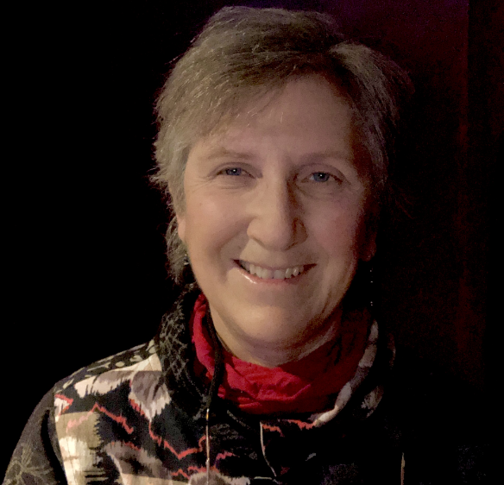
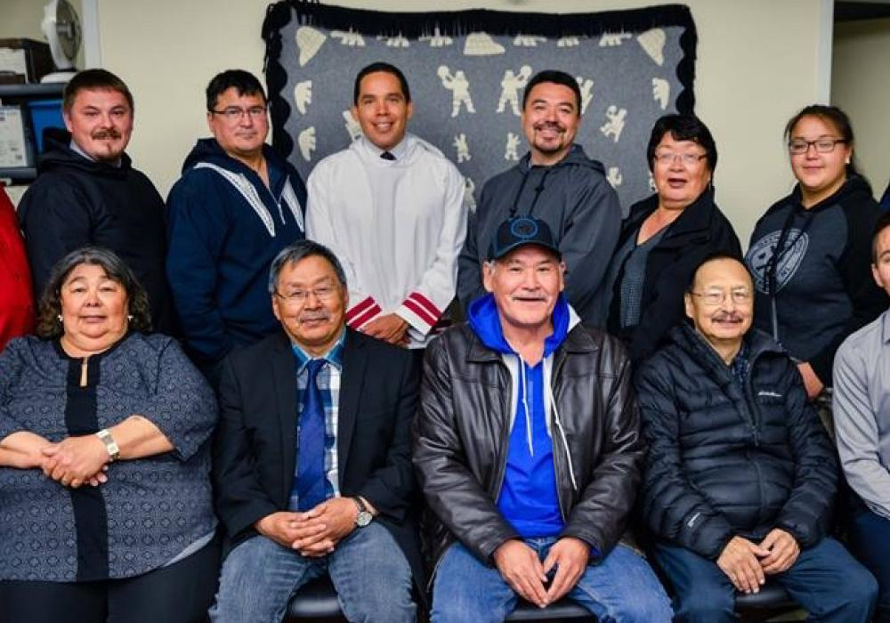
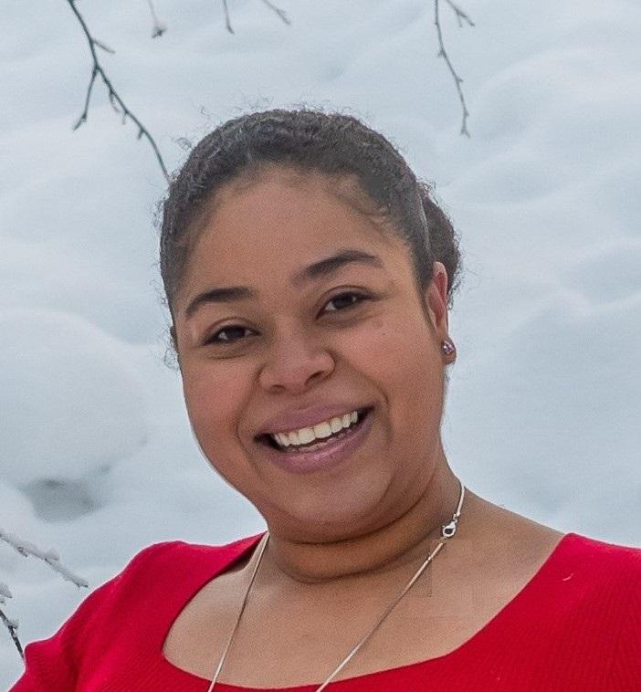
Meet our Board
Appointed by the Inuvialuit Game Council
Appointed by the Yukon Government
Appointed by the Government of Canada
EIRB IGC Member
Appointed July 19, 2022 –
August 20, 2025
Ethel-Jean Gruben
EIRB GNWT Member
Appointed October 14, 2022 – September 30, 2025
Kate Hearn
Bruce Mclean
EIRB IGC Member
October 3, 2022 –
March 31, 2025
Gerald Inglangasuk
EIRB Yukon Member
February 8, 2021 –
March 31, 2024
EIRB Canada Member
Appointed October 14, 2022
– September 30, 2025
Cynthia Ene
EIRB Community Tour, 2023 - The EIRB
Notes:
It is important to emphasize that the Review Board is set up as non-partisan organizations. Each member is expected to contribute as an experienced individual. This approach has worked well.
At this moment we do have a vacancy for IGC, so if anyone here is interested, kindly let me know after the presentation.
Next up we have the appointed members by the Inuvialuit Game Council

Slide 5
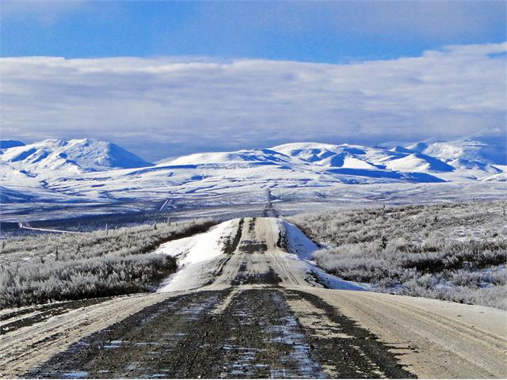
The Environmental Impact Review Board
Government Appointees
Government Appointees
IGC Appointees
IGC
Yukon
IGC
Chair
Canada
GNWT
IGC
EIRB Community Tour, 2023 - The EIRB
Notes:
As is the case with the co-management BODIES, the Review Board is comprised of an equal number of Inuvialuit and government representatives.
The Chair is appointed by the Federal Government, with the consent of the Inuvialuit.
One member each is nominated by the governments of Canada, Yukon, and the Northwest Territories and three members are appointed by the Inuvialuit.

Slide 6

The IFA, ISR & Co-Management Boards
EIRB Community Tour, 2023 - The IFA, ISR & Co-Management Boards
Notes:
To make things simple I will be using acronyms for IFA which is Inuvialuit Final Agreement; ISR Inuvialuit Settlement Region.

Slide 7
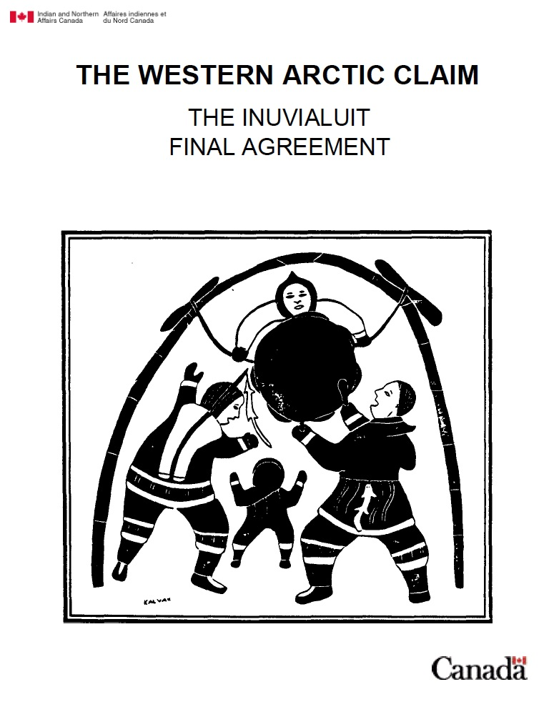
The Inuvialuit Final Agreement
(IFA)
Inuvialuit Final Agreement Principles
As a results of the establishment of the Inuvialuit Development Corporation (IDC), the IFA aims to promote full participation of the Inuvialuit's in the Northern Canadian Economy, by developing an adequate level of economic self reliance and a solid economic base.
Preserve Inuvialuit cultural identity and values within a changing northern society.
Enable Inuvialuit to be equal and meaningful participants in the northern and national economy and society.
Protect and preserve the Arctic wildlife, environment and biological productivity.
EIRB Community Tour, 2023 - The IFA, ISR & Co-Management Boards
Notes:
After some 8 years of the negotiations between COPE (the Committee for Originals Peoples Entitlement, representing the Inuit Peoples of the Western Arctic: the Inuvialuit) and the Federal Government of Canada, the Inuvialuit Final Agreement was signed on 5 June 1984. It was ratified by the passage of the Western Arctic (Inuvialuit) Claims Settlement Act.
Three guiding Principles of the IFA:​
To preserve Inuvialuit cultural identity and value​
Enable Inuvialuit to be equal and meaningful participants in the northern and national economy & society​
Protect and preserve the Arctic wildlife, environment and biological productivity

Slide 8
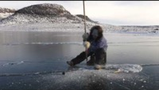
Inuvialuit Settlement Region
EIRB Community Tour, 2023 - The IFA, ISR & Co-Management Boards

Slide 9
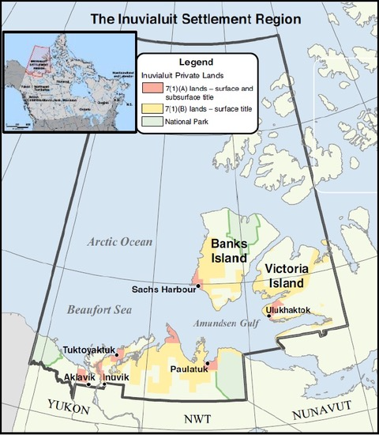
Inuvialuit Settlement Region (ISR)
The Inuvialuit Settlement Region which was negotiated in the signing of the Final Agreement encompasses an area of approximately 1 million square kilometers in the Canadian western arctic, including the Yukon North Slope; and the Mackenzie Delta and the western Arctic islands, which are known as the Western Arctic Region (so everything within the black border).
The Inuvialuit live in six communities in the Settlement Region: Aklavik, Inuvik, Tuktoyaktuk, Paulatuk, Sachs Harbour and Ulukhaktok.
Private lands, for which the Inuvialuit own sub-surface and/or surface rights, are associated with each of these communities.
The remaining area in the Settlement Region is in Territorial land and Public land.
EIRB Community Tour, 2023 - The IFA, ISR & Co-Management Boards
Notes:
As we saw in the video, the ISR covers approximately 1 million square kilometers in the Canadian western arctic, including the Yukon and the Mackenzie Delta and the Western Arctic islands.

Slide 10

Inuvialuit Game Council
AKLAVIK HTC
INUVIK
HTC
PAULATUK HTC
SACHS HARBOUR
HTC
TUKTOYAKTUK
HTC
ULUKHAKTOK HTC
EIRB Community Tour, 2023 - The IFA, ISR & Co-Management Boards
Notes:
Before I get started with co-management boards.
The Inuvialuit Game Council (IGC) highlighted in red was created, in anticipation of the eventual signing of the Final Agreement. The Inuvialuit Game Council was established in 1983. It is different from the other boards as it It has 100% Inuvialuit membership which includes a chairman and board members involving two representatives from each of the six Hunters’ and Trappers’ Committees in the Settlement Region. The Game Council Chair is elected by all the HTC Directors.
The IGC is responsible for appointing Inuvialuit members for the co-management bodies.

Slide 11
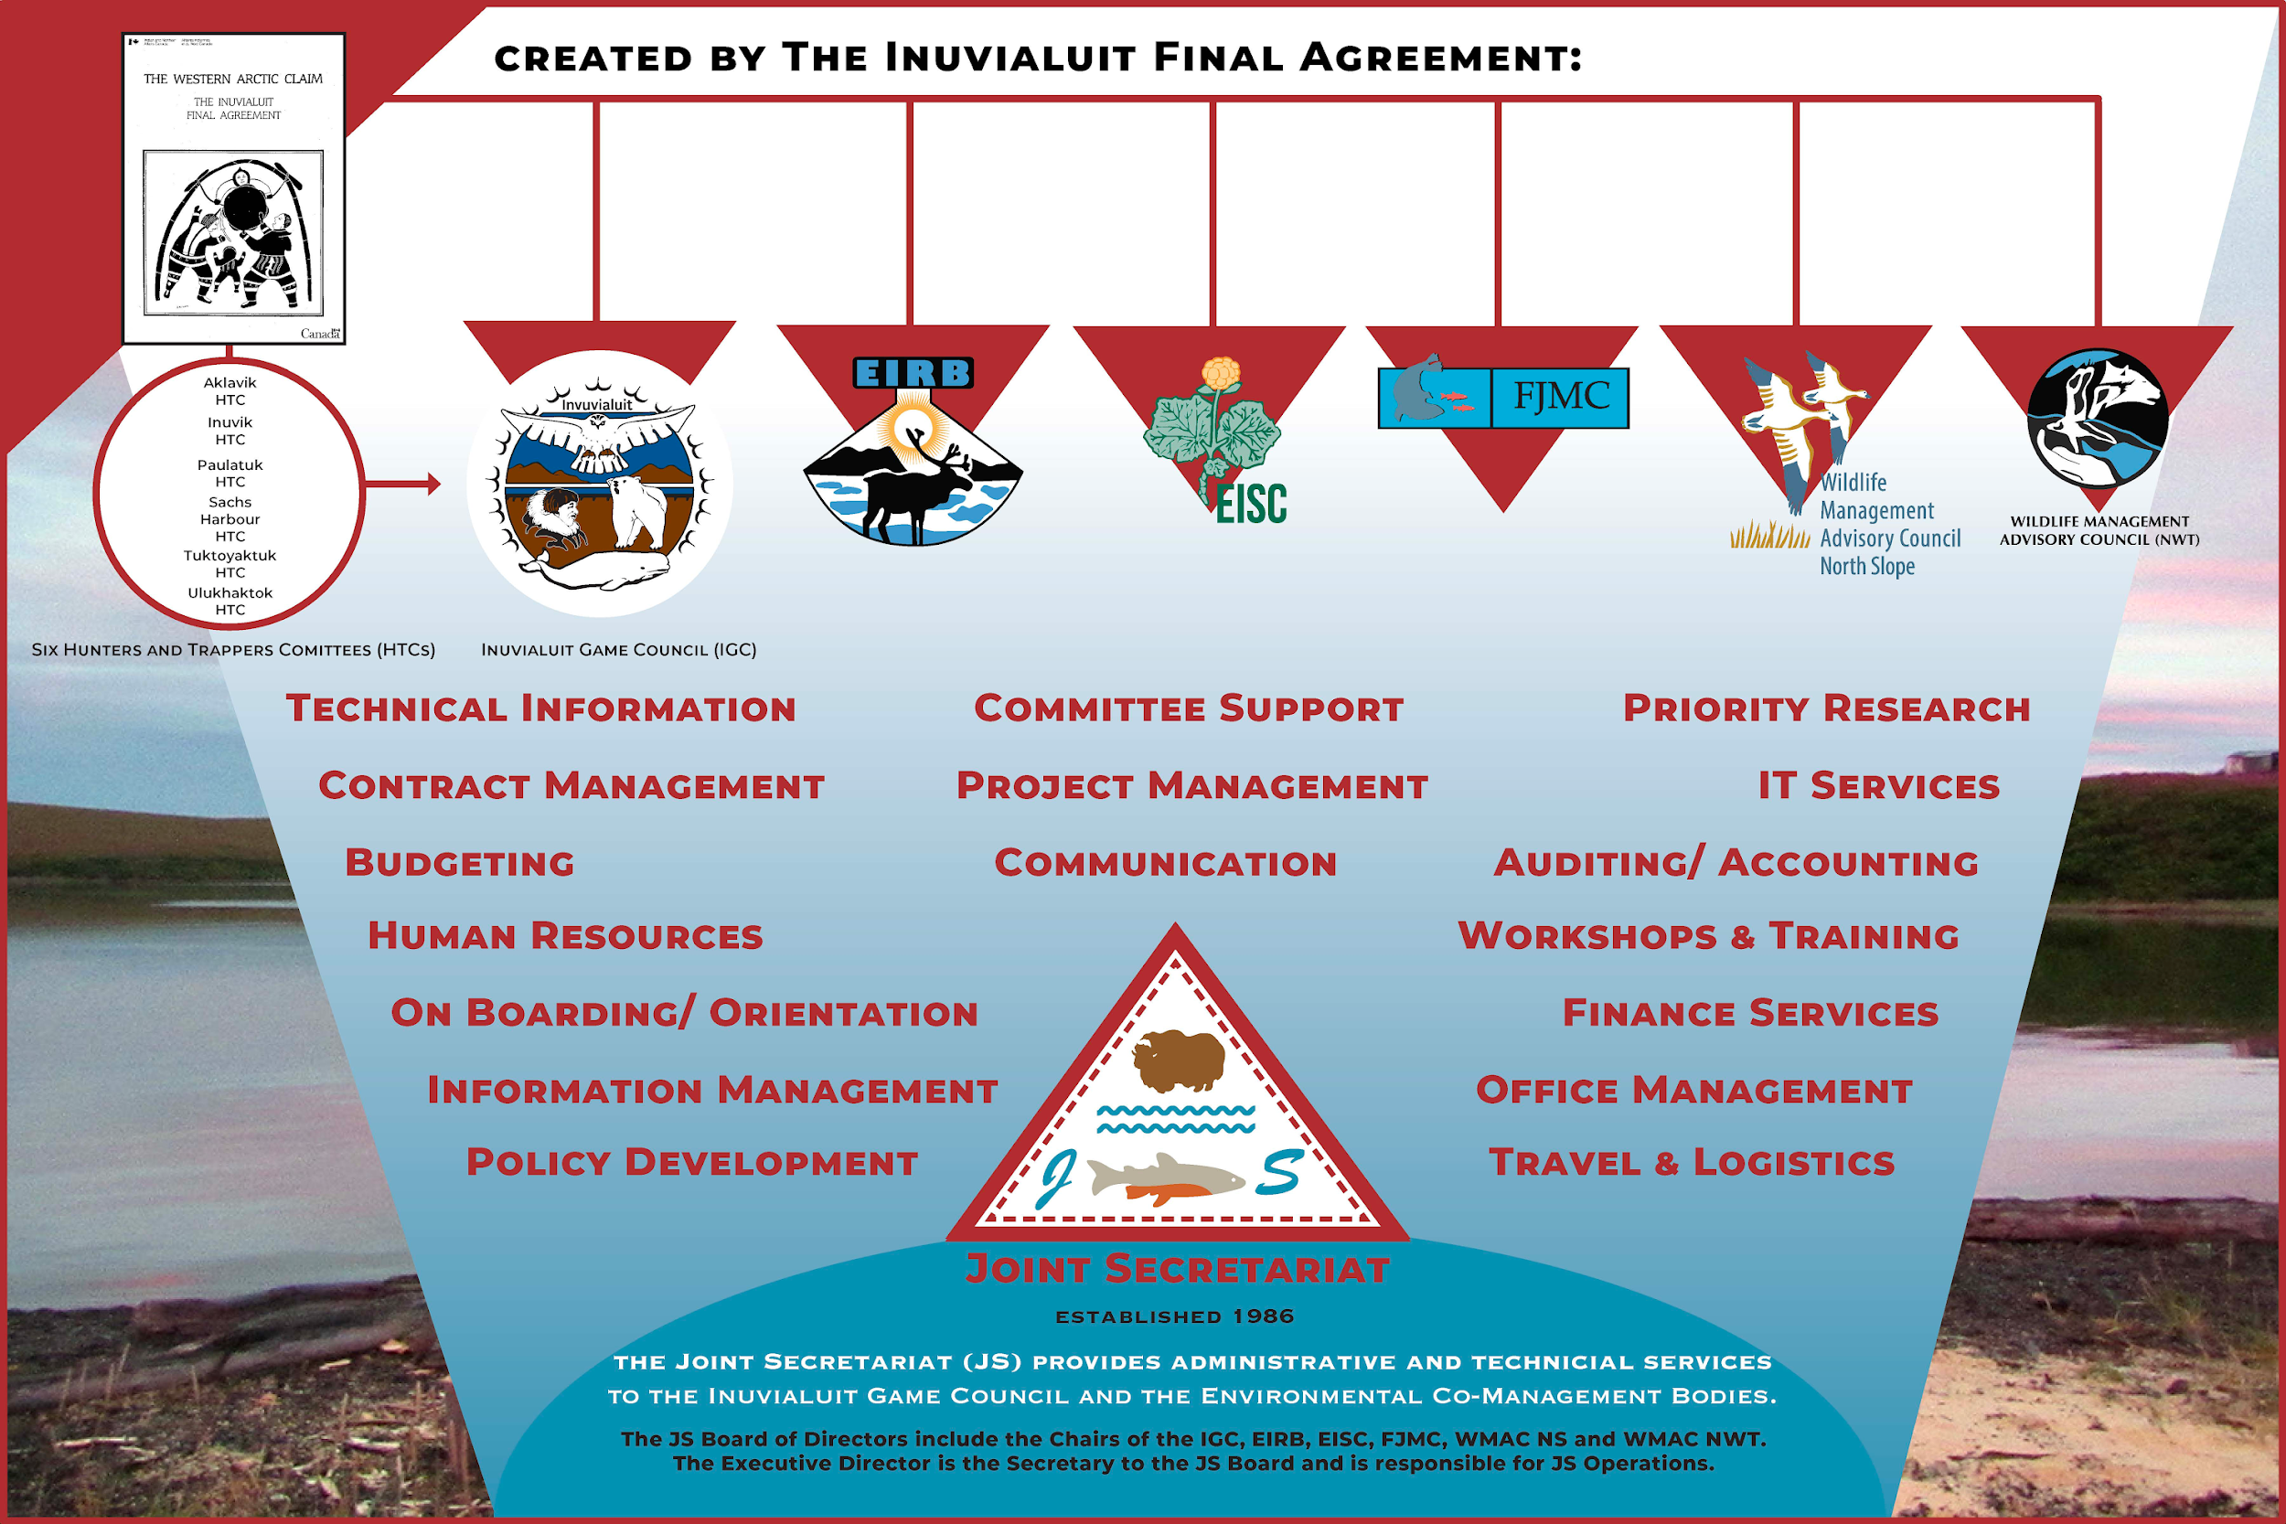
Notes:
The Final Agreement enabled a system of joint management, involving both the Inuvialuit and the government, to be established. This “co-management process”, as it has now become known, is considered to be a world-class example of integrated resource management.
At the foundation of this process are five co-management BODIES:
the Wildlife Management Advisory Council (Northwest Territories),
The Wildlife Management Advisory Council ( North Slope),
The Fisheries Joint Management Committee,
The Environmental Impact Screening Committee, and
The Environmental Impact Review Board.
Each group is comprised of an equal number of Inuvialuit and government members, with a mutually agreed upon Chair. This composition guarantees the inclusion of indigenous knowledge and cultural sensitivity in wildlife and environment management.
The Joint Secretariat provides Administrative, technical and logistical to Inuvialuit Organizations and Co-management Boards

Slide 12

The EIRB decides whether a project should proceed and, if so, under what specific terms and conditions. In making its decision, the EIRB considers the need for wildlife compensation, mitigation, and remedial measures.
The Environmental Impact Review Board
The Environmental Impact Review Board (EIRB) conducts environmental impact reviews for proposed developments in the Inuvialuit Settlement Region that have the potential for significant adverse environmental effects.
EIRB Community Tour, 2023 - The EIRB

Slide 13

EIRB Authorities and
Mandate
Making sure that a proposed development should proceed, and if so with what terms and conditions
Whether the development proposal should be subject to further review and, if so, the data or information required should be submitted
EIRB Community Tour, 2023 - The EIRB

Slide 14
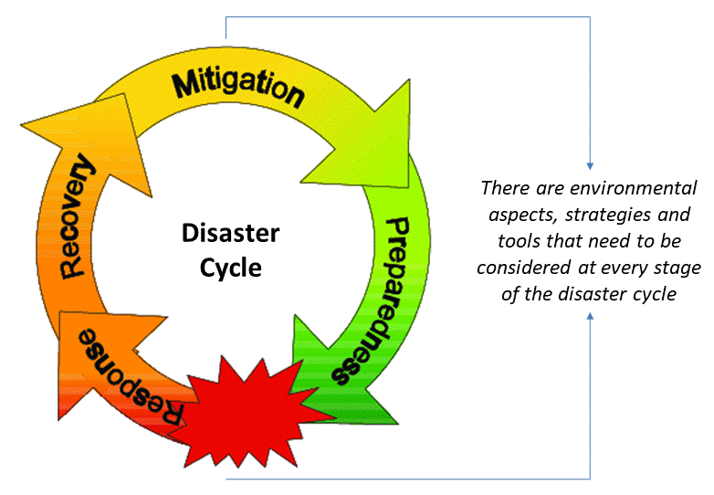
EIRB Authorities and
Mandate
Identify what mitigative and remedial measures are required, and which measures are necessary to minimize any negative impact on wildlife harvesting (Section 11 & 13 of the IFA) and
The Developer’s potential liability is estimated and determined on a worst-case scenario and based on a balance of factors
EIRB Community Tour, 2023 - The EIRB

Slide 15
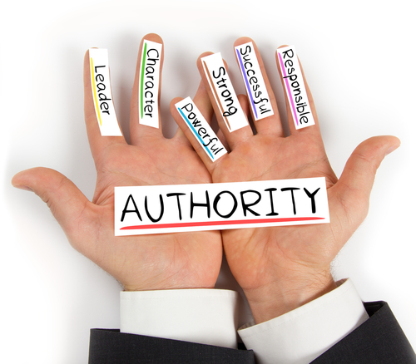
EIRB Authorities and Mandate
The Review Board’s authorities and mandate are limited to the environmental impact review process set up under the IFA.
The EIRB operates exclusively within the scope of the authority assigned to it in Sections 11, 12 and 13 of the IFA, and reflected in the Board’s Rules of Procedures and Guidelines
EIRB Community Tour, 2023 - The EIRB

Slide 16
The Review Board provides recommendations to specified government authorities on whether a development should proceed and under what terms and conditions
The Review Board does not make determination on whether Inuvialuit or other Indigenous rights, are protected under the IFA and the Constitution Act, 1982, are likely to be subject to infringement from a proposed development
The Authorities and Mandate of the EIRB
The Review Board’s responsibilities do not extend into the issuance of regulatory permit or license approvals, or monitoring, compliance or enforcement related to those permits, licenses or other authorizations
The Review Board is not directly responsible for Crown consultation in relation to a proposed development, nor does it determine the adequacy of Crown consultation
EIRB Community Tour, 2023 - The EIRB

Slide 17

A Referral Decision Letter and Reasons for Decision document prepared by the Screening Committee that provides the reasons why the Screening Committee believe the proposed development needs additional environmental review
A copy of all information contained in the Screening Committee’s Proceeding Record that was considered by the Screening Panel in making the screening decision
A contact list of Parties to the Proceedings of the Screening Committee
The transition from Environmental Impact Screening (EISC) to Environmental Impact Review Process
EIRB Community Tour, 2023 - The EIRB

Slide 18

The Review Process
The Inuvialuit Final Agreement
2) Flexibility of the Review process
3) The Review Board’s responsibilities and principles
EIRB Community Tour, 2023 - The EIRB
Notes:
1) The EIRB has created a public environmental impact review process consistent with and derived from the authority of the Inuvialuit Final Agreement.
2) Was designed to be flexible enough to enable the Review Board to reasonably and expeditiously complete each environmental impact review in a manner that reflects the scale of the proposed development, and its potential for social, economic, cultural and environmental effects.
3) The key principles and responsibilities expected by the Review Board to guide the environmental impact review process, and then outlines the process the Review Board follows to complete an environmental impact review

Slide 19
The Review Process
The Environmental Impact Review is a six-phase process, as shown here below.
The Initiation phase
Section 4
The Scoping Phase
Section 4.5
The EI Statement Phase
Section 4.6
The Technical Review
Phase
Section 4.7
The Hearing Phase
Section 4.8
The Decision Phase
Section 4.9
The Six Phases of the Environmental Impact Review Process
EIRB Community Tour, 2023 - The EIRB
Notes:
The EIR Initiation phase: is mainly the referral documents received by the screening committee
The Scoping phase is the stage that sets out what needs to be assessed in the environmental impact assessement to help define how to approach the assessment and what information may be needed to identify the likely significance effects from the development.
EIS development : Environmental Impact Statement

Slide 20
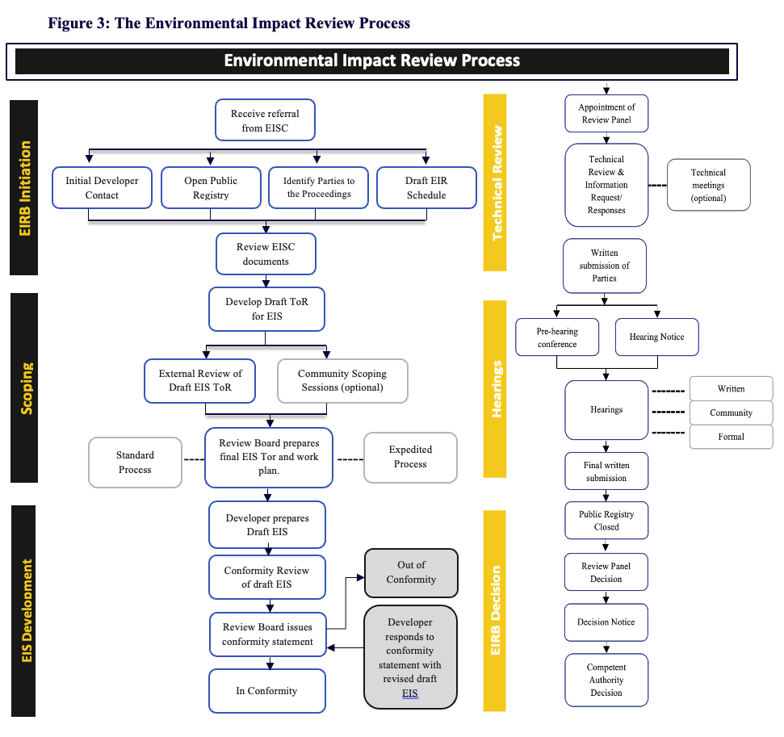
The Six Phases of the Environmental Impact Review Process
Establishment
Public Notice
Transboundary Considerations
Review Schedule & workplan
EIRB Community Tour, 2023 - The EIRB
Notes:
The EIRB will establish a specific file on the EIRB website for the review of the development proposal; it will publish a Public Notice of Referral; and identify parties to the proceedings. Public Notice will invite organizations and individuals to register as Parties to the Proceeding, in accordance with Section 2.2 of the Rules. Submissions from Members of the Public will be accepted by the Review Board. Transboundary Considerations will be considered for development proposals in or impacting on the ISR or Yukon. The EIRB will draft a Review Schedule and Work Plan as a guide to indicate when certain tasks related to the Environmental Impact Referral process are anticipated to occur and be completed. The Review Board - and after the receipt of the accepted EI Statement - will consider written requests, to adjust the scheduled timeframe for a particular task.

Slide 21


How to get involved?
Register
Decision & Recommendations
Participate
Evidence
EIRB Community Tour, 2023 - The EIRB
Notes:
All individuals and organizations are required to register with the EIRB before they can participate in the proceedings. The applicant is asked to complete a Registered Party Application which can be found on the EIRB website. I will go through the application a little later
Once you have become a registered party you can now follow and participate in the proceedings. You will be kept up to date on all matters and be included on the distribution list.
Once you are a registered party, any relevant information you provide to the EIRB will be submitted as evidence.
All evidence that has been submitted will be used by the EIRB to help support their decision and recommendations.
WHO SHOULD GET INVOLVED?
Community Members
Co-management bodies: FJMC, WMAC NT/NS
Inuvialuit Organizations: IGC, IRC and
Members of Community HTC’s
Government agencies and departments

Slide 22
What can you offer to the Proceedings?
Research
Expertise
Expertise brings skills and knowledge from practice.
Experience brings the local knowledge and history and most importantly, all traditional knowledge.
Research brings academic findings – research-based evidence.
Experience
EIRB Community Tour, 2023 - The EIRB

Slide 23


When do you get involved?
EISC
Commenting Period
Phase 3
EIRB
Commenting Periods
Scoping stage
Environmental Impact Statement Outline
Draft Environmental Impact Statement Hearings
Formal Hearing
EIRB Community Tour, 2023 - The EIRB
Notes:
During the Assessment and Review process, there are several opportunities to be involved:
The commenting periods for the outline and draft of the EIS
Then during the proceedings, you can be involved during the Preparation period and hearing period.
Please remember, you will need to register and gain Party Status to be able to provide information before the EIRB review panel.
ALSO, YOU CAN ALWAYS CONTACT THE EIRB OR GO ON OUR WEBSITE FOR MORE INFORMATION

Slide 24
Identifies the goals, authorities and mandate provided by the IFA to the Review Board
Section 2
How to use
the
review guidelines
Describes the transition between the initial Environmental Impact Screening and subsequent (if necessary) Environmental Impact Review processes in the ISR
Section 3
Outlines principles underlying and steps involved in the six-phase Environmental Impact Review process, along with the roles and responsibilities of parties within this process.
Section 4
Discusses general and specific information requirements of Environmental Impact Reviews, with specific emphasis on information the Developer needs to include in its Environmental Impact Statement.
Section 5
EIRB Community Tour, 2023 - The Review Guidelines
Notes:
On the table in the back you will find our guiding principles.
And this is how we use it when conducting a review:

Slide 25

Questions and Comments
ALICE.LUTALADIO@JOINTSEC.NT.CA
EIRB Community Tour, 2023 - The EIRB

Slide 26
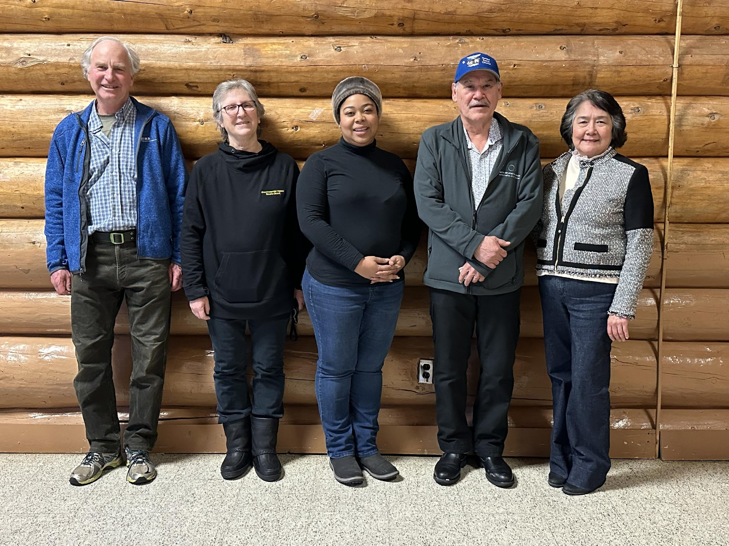
Thank you
Environmental Impact Review Board
February 2023
Quyanainni

